Slide 1

KaeTE: Towards Practical Neural Traffic Engineering
with Lagrangian Duality and Learning-to-Optimize
Zirui Ou, Yanghao Zhang, Jie Gui, Qun Huang
Notes:
Good morning. I am Zirui Ou. Today, I am going to present our work “xxx”, this is a joint work with Yanghao, Jie, and Qun.

Slide 2
Traffic Engineering (TE)
Take topology, capacities, and the traffic matrix
Choose split ratios over a small candidate path set
Maximize admitted traffic without overloading links
Topology +
capacities
TE
solver
Split
ratios
Traffic
matrix
maximize throughput
Notes:
Typically, traffic engineering (TE) needs to solve a new optimization instance whenever traffic, topology, or link capacities change.
A centralized TE controller repeatedly closes this loop. It observes the current topology, link capacities, and traffic matrix; selects a small path set; and computes split ratios. Here the objective is total admitted traffic. The important operational constraint is that the traffic carried by every link must stay within its capacity. An LP solver can find the exact optimum, but its latency can become the bottleneck when traffic or network conditions change faster than the solve cycle. This is why learned TE solvers are attractive in the first place.

Slide 3
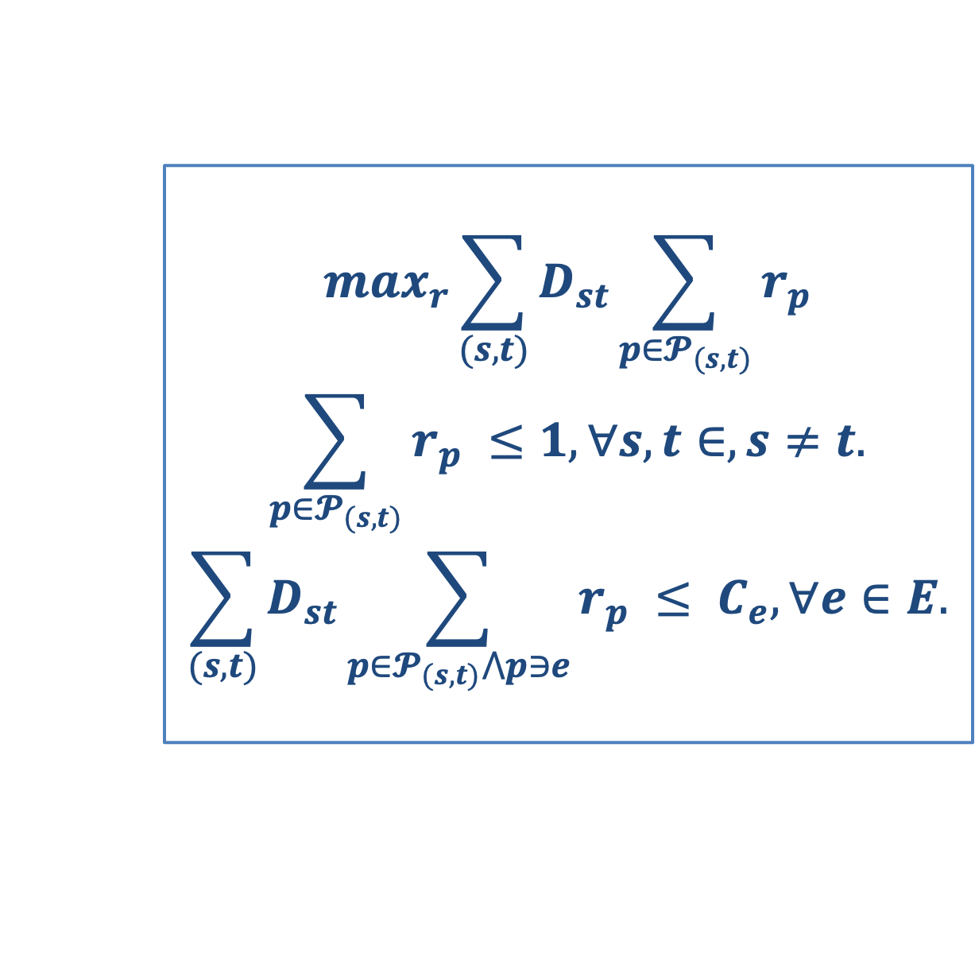
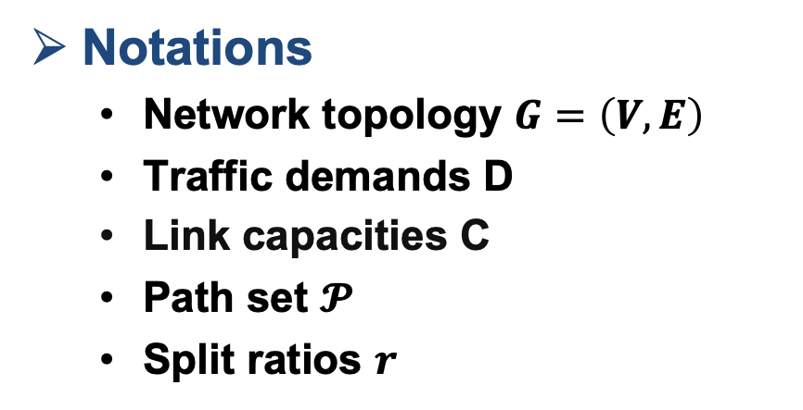
Problem Formulation
Notations
  Network topology $G=\left(V,E\right)$
  Traffic demands D
  Link capacities C
  Path set $𝓟$
  Split ratios $r$
$$\max_{r}\sum_{(s,t)}{D_{st}\sum_{p∈𝓟_{(s,t)}}{r_{p}}}$$
$$\sum_{p∈𝓟_{(s,t)}}{r_{p} ≤1, ∀s,t∈, s≠t.}$$
$$\sum_{(s,t)}{D_{st}\sum_{p∈𝓟_{(s,t)}⋀p∋e}{r_{p} ≤ C_{e}, ∀e∈E.}}$$
Commodity constraint
Link-capacity constraint
  Admit more traffic without overloading any link
Notes:
Now let us formalize this throughput objective. For each source-destination commodity (s,t), D is its demand, P_{s,t} denotes its candidate path set, and r_p is the admitted fraction placed on candidate path p. The objective sums admitted traffic over every commodity and path. For the throughput objective, there are two kinds of constraints. Specifically, the first constraint keeps each commodity within its demand budget and enforces non-negative ratios. And the second defines link utilization: the total traffic routed through link e, divided by capacity C e, must be at most one. This is a linear program. In reality, the network topology, the link capacities, and the traffic demands may evolve overtime due to failure or maintenance, which results in dynamic network conditions.

Slide 4
Limitations of Existing Works
 | FIGRET | Teal | DOTE | HARP | Geminet | KaeTE (this work)
Dynamic network conditions | ✗ | △ | ✗ | ✓ | ✓ | ✓
Throughput objective | ✗ | ✓ | ✓ | ✗ | ✗ | ✓
KaeTE targets the missing intersection: dynamic conditions × throughput
△ partial support within a fixed-topology family
Notes:
However, there are still some limitations on existing works.
The two rows are the requirements we just established: support changing network conditions, and directly optimize the throughput objective. DOTE supports throughput but assumes a fixed topology. HARP and Geminet handle changing network conditions but target other TE objectives. Teal supports throughput and offers partial adaptation through iterative refinement, yet remains centered on a fixed-topology family. The triangle records that distinction. KaeTE is designed for the missing intersection: it checks both rows in one pipeline.

Slide 5

Key idea: KaeTE learns in the dual space
Primal formulation
Dual formulation
Lagrangian duality
Constrained split ratios
Commodity constraints keep each demand within its budget
Link capacities couple all commodities
Direct learned updates must respect these constraints (which is hard)
Per-link prices $λ$
Iteratively refine with “gradient descent”
Simple constraints with respect to link prices
Recover routing
Map $λ$ back to split ratios $r$
Notes:
The limitations point to a natural strawman solution. The original variables are split ratios r, and they live in a feasible set tied together by commodity and link-capacity constraints, which are hard to deal with simultaneously. Therefore, KaeTE applies Lagrangian duality to solve the dual problem, which is an unconstrainted optimization problem with respect to the link prices. Specifically, the coupled capacity constraints are absorbed into the dual objective, and the iterative optimizer refines one non-negative link price λ_e per link. After the iterative update, KaeTE recovers split ratios from the link prices.
However, this does not mean that deployment constraints disappear. A finite number of dual updates can still produce raw split ratios that overload a link, and the primal-dual mapping is not automatically unique. Those are exactly the recovery, update, and feasibility challenges addressed by the next three design slides.

Slide 6
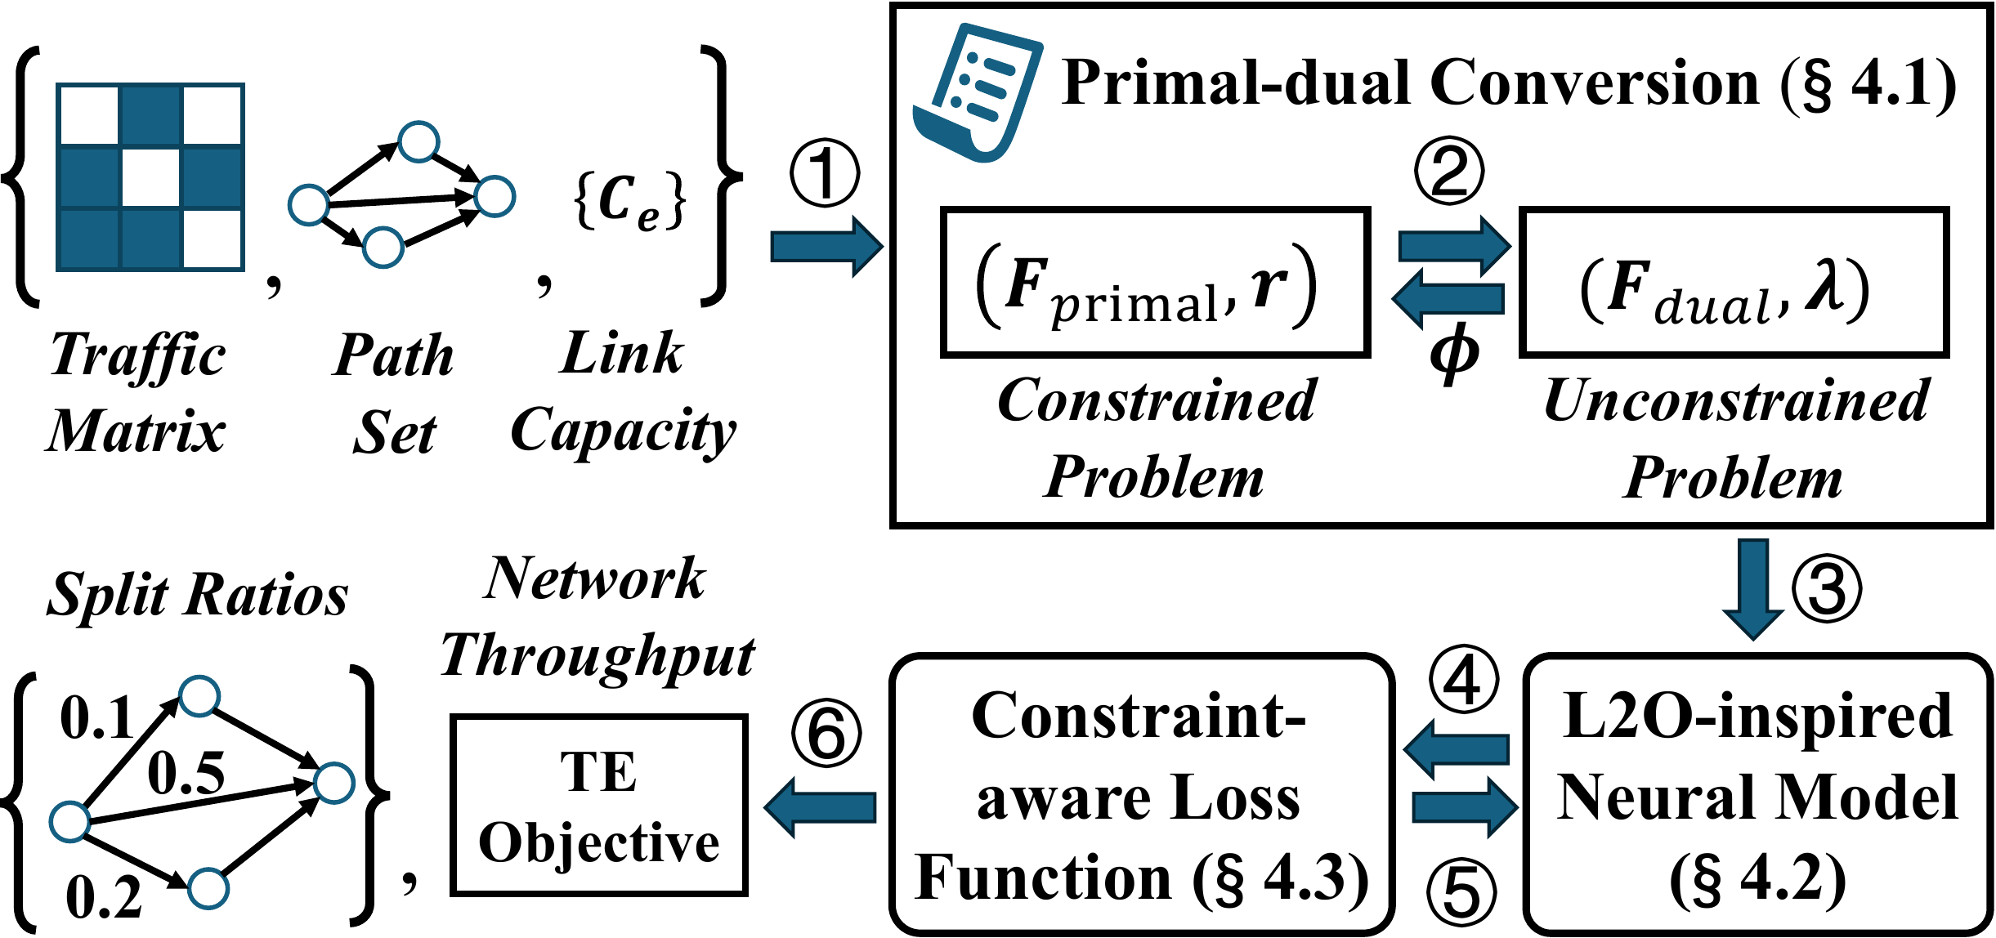
KaeTE workflow
dynamic inputs → dual refinement → feasible routing
Notes:
We first introduce the complete KaeTE workflow. First, the network operator specifies two parameters, namely iteration time T and regularization term tau. During deployment, a new traffic matrix, path set, and capacity vector instantiate the constrained primal problem. Regularization gives a reliable mapping between primal routing variables and the unconstrained dual prices. KaeTE then runs a fixed number of learned refinement steps on those prices with the Learning-to-optimize (L2O) neural model. At each step, the dual solution maps back to candidate split ratios. Finally, a constraint-aware loss scales those ratios before evaluating throughput, so training rewards solutions that are useful after feasibility enforcement. The final output is the objective value and a set of split ratios that can actually be deployed.

Slide 7
Primal-dual Conversion via regularization
Linear throughput
Regularized objective
Non-unique optimum
  The recovered split ratios may not be unique
Deployment risk
  The same dual point may imply different routings
  Recovery becomes unstable
L2 Regularizer
  Strongly convex
  To ensure uniqueness
Closed-form recovery
  Unique split ratios from link prices
tau: fidelity ↔ stability
Notes:
The first design challenge is primal recovery, which means how to recover the split ratios when optimal link prices are found. The original throughput objective is linear, so its optimum can be non-unique. Strong duality may still hold under Slater's condition, but one dual solution does not identify a stable, unique routing solution. KaeTE adds a demand-weighted quadratic regularizer. The resulting objective is strongly convex, which makes the primal solution unique. For a fixed dual-price vector, each commodity can then recover its split ratios with a closed-form simplex projection. The coefficient tau controls the engineering trade-off: large enough for conditioning and stable recovery, but small enough to stay close to the original throughput objective.

Slide 8
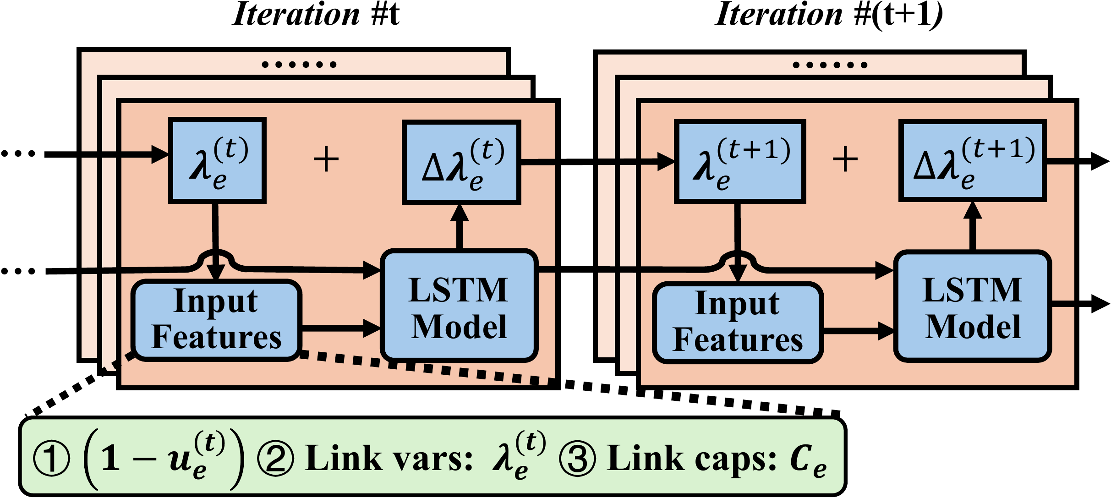
Refinement via learning-to-optimize model
per-link LSTM: {1 - uₑ, λₑ, Cₑ} → Δλₑ
Notes:
The second challenge is convergence within limited iterations. Hand-designed gradient descent must choose both the initial link prices and a learning rate schedule, and poor choices waste iterations or converge to a weak solution. KaeTE learns both pieces. An MLP initializes each link price from the aggregate demand crossing that link and its capacity. Then a shared per-link LSTM produces the update delta lambda from three local features: the dual gradient, the current price, and the link capacity. Because the same update operator is applied independently to every link and across iterations, the model is naturally compatible with different link sets and network conditions.

Slide 9
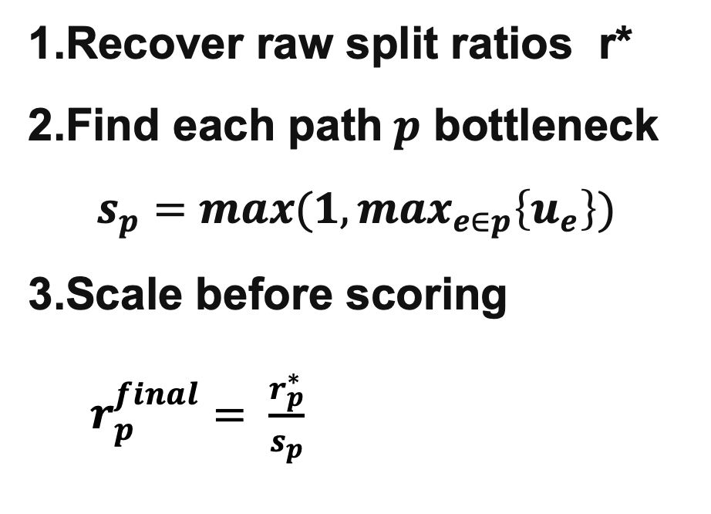
Constraint-aware loss function
1.Recover raw split ratios r*
2.Find each path$p$ bottleneck
$s_{p}=max(1, \max_{e∈p}\left\{u_{e}\right\})$
3.Scale before scoring
$r_{p}^{final}= \frac{r_{p}^{∗}}{s_{p}}$
Feasible by construction
uₑ ≤ 1 for every link
The training loss sees the scaled routing.
Notes:
The final design challenge is feasibility. A finite number of learned dual updates can still produce raw split ratios that overload a link. KaeTE therefore computes every path's scaling factor as the maximum utilization among the links on that path, lower-bounded by one. Dividing the raw path ratio by this factor guarantees that no traversed link exceeds capacity. Crucially, KaeTE uses these scaled ratios inside the training loss when it computes throughput. Feasibility is not a post-processing surprise at deployment time; it directly shapes what the learned optimizer is rewarded for producing.

Slide 10
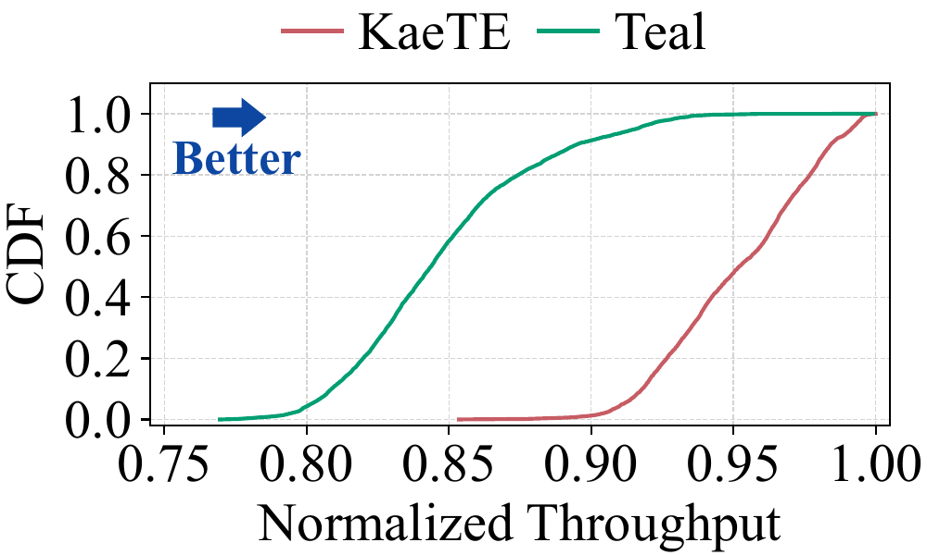
Evaluation: dynamic topology (DynGEANT)
1st percentile
  KaeTE 89.76%
  Teal 78.86%
95% of samples
  KaeTE ≥ 90.03%
  Teal ≥ 80.13%
20 unseen test topologies
Notes:
We first test generalization under dynamic network conditions. DynGEANT contains fifty topologies: twenty-five for training, five for validation, and twenty unseen topologies for testing. Normalized throughput divides each learned solution by the Gurobi optimum, so values closer to one are better. The entire KaeTE CDF shifts right. At the first percentile, KaeTE reaches 89.76 percent versus 78.86 for Teal. Looking at the lower tail another way, 95 percent of KaeTE samples exceed 90.03 percent of optimum, while Teal reaches only 80.13 percent. This is the robustness benefit that matters when the topology itself changes.

Slide 11
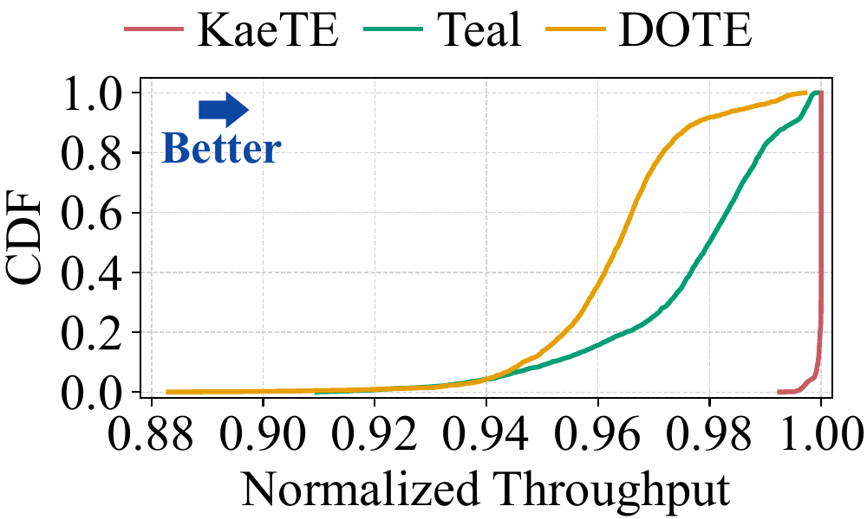
Evaluation: static topology (GENAT)
Minimum over tests
  KaeTE > 99.25%
  Teal 90.96%
  DOTE 88.30%
Every KaeTE sample
  > 99.25% of optimum
Notes:
On the static GEANT topology, KaeTE also preserves solution quality. Here we train on the first 75 percent of traffic matrices and test on the remaining 25 percent. The comparison includes Teal and the paper's simplified fixed-topology DOTE variant. KaeTE achieves more than 99.25 percent of the Gurobi optimum for every testing sample. By contrast, the minimum normalized throughputs are 90.96 percent for Teal and 88.30 percent for DOTE. The sharp mass near one shows that learned iterative refinement can be both fast and consistently near-optimal when the topology is fixed.

Slide 12
Conclusion
One practical target
  dynamic conditions + throughput objective
Three complementary mechanisms
  regularization · per-link L2O · feasibility scaling
Evidence across both regimes
  better DynGEANT tails; >99.25% on GEANT
Takeaway：optimization structure + learned updates
fast · adaptive · capacity-safe split ratios
Notes:
To conclude, KaeTE targets the combination that practical neural TE has been missing: changing network conditions and a capacity-constrained throughput objective. Its contribution is the composition of three ideas: regularization for reliable primal recovery, a shared per-link learned optimizer for fast dual refinement, and constraint-aware scaling for deployable outputs. The current results show stronger tails on unseen DynGEANT topologies and near-optimal performance on static GEANT. The broader message is that learning does not need to replace optimization structure; it can learn the part of the solver that benefits most from experience. Thank you.

Slide 13
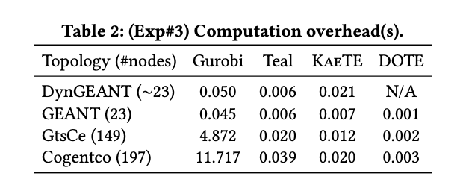
Backup#1
Computation overhead
  On large topology, the computation overhead of KaeTE is close to Teal.

Slide 14

Backup#2
Why the regularized problem can approximate the primal problem well?
  One can always closely approximate the origin problem with a small enough regularization coefficient $τ$.

